Slide 1
Smart and Green City Implementation Using Automated Budgeting
Team members: Abhinav Srivastava, Mahalakshmi Arunachalam & Saurabh Kulkarni

Slide 2
Introduction
Lack of implementation of greener practices in cities is due to lack of funding in most cases. Though the funds are available they are not allocated properly and are not utilized and their potential benefits remain untapped.
Our solution is Automated budgeting and utilization of funds and resources to reduce the carbon footprint of the city which ultimately helps in achieving the goal of making smart and green city.
The main aim is to improve the quality of life of people in the city by following greener practices.

Slide 3
Use Cases
Budget Allocation by Predictive Analysis of past data by Budget Admin
Additional Budget Allocation by Green Manager
Additional Budget Approval by Mayor
Tracking Budget Expenditure at Organization level

Slide 4
Actors
Mayor
Budget Admin
Green Admin
Health Admin
Education Admin
Infrastructure Admin
Tourism Admin
Industries Admin
Automobile Admin

Slide 5
Object Model
CSV Util
EcoSystem
DB4OUtil
Network
Configure A System
Budget
Enterprise Directory
Budget Enterprise
Health Care
Enterprise
Green Enterprise
Education
Infrastructure
Organization
Tourism
User Account Dir
Employee Dir
Automobiles
Industries
User Account
Employee
Work Queue
* Role
Work Request
Hospital Admin
Education Admin
Infrastructure Admin
Budget Admin
Green Admin
Industries Admin
Automobile Admin
Tourism Admin
Mayor
* Present Across All

Slide 6
Threats
Unauthorized access to previous and current budget data
Access related threats
Modification and manipulation of previous budget performance

Slide 7
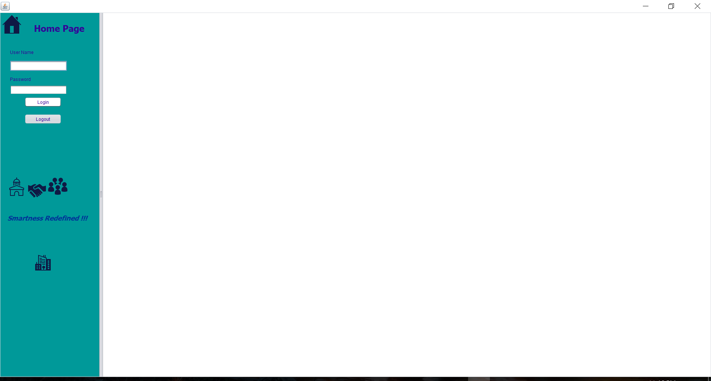
Login Home Screen

Slide 8
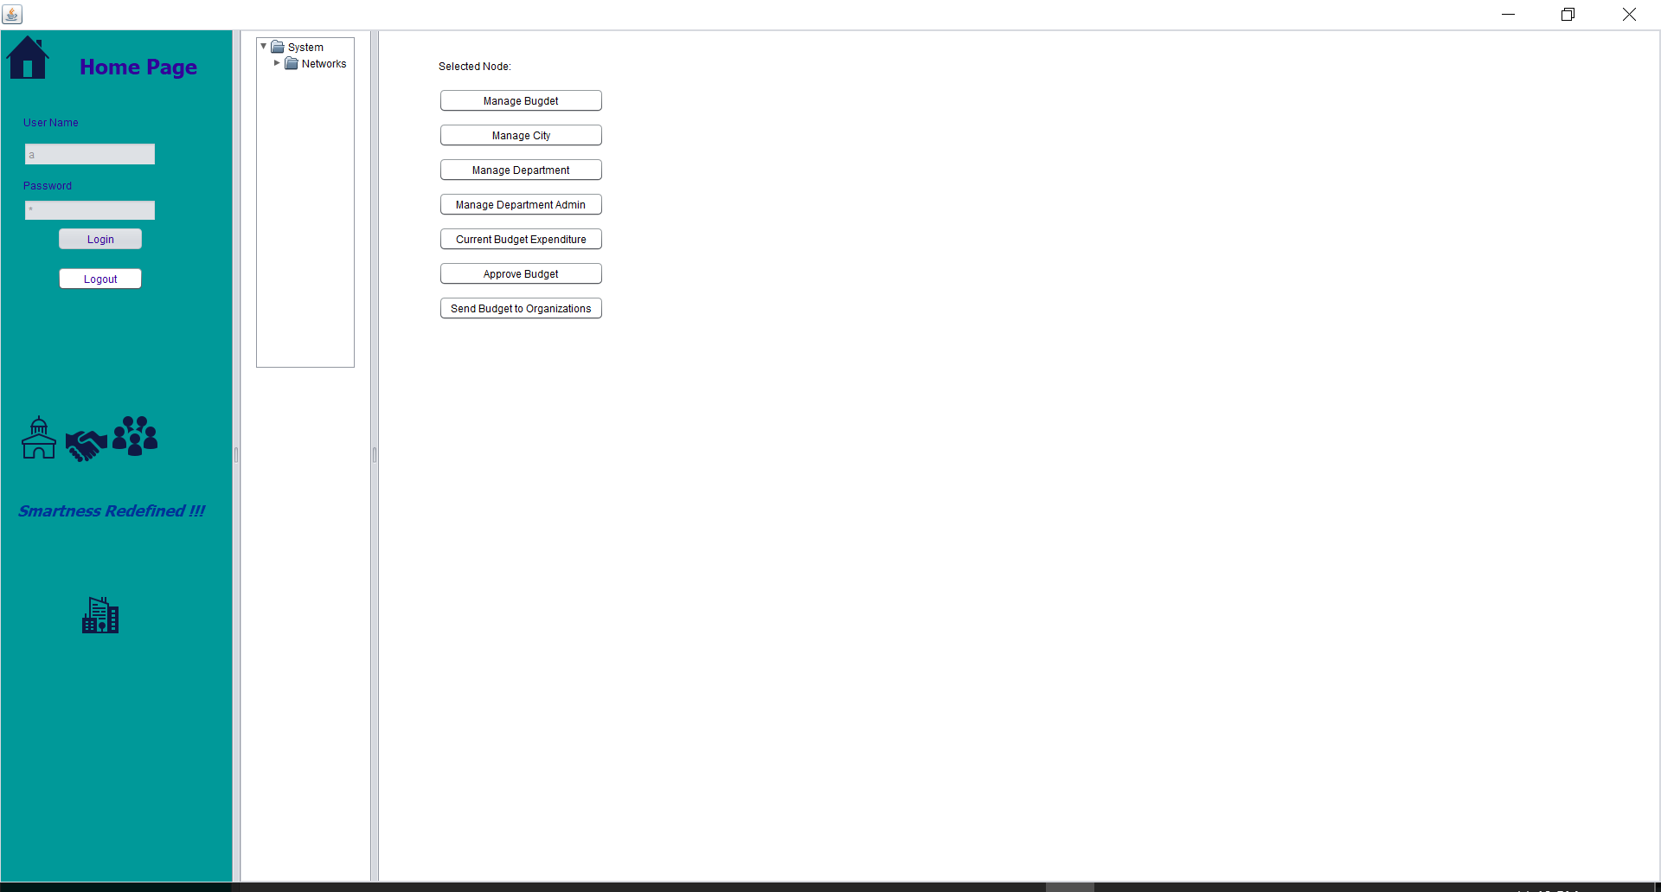
Mayor Work Area Panel

Slide 9
Demo

Slide 10
Thank You

